Slide 1
CISCO INTERNSHIP PROJECT
BY PRANJAL PATEL (2nd year, CSE Dept.)

Slide 2
INTRODUCTION
I am a student of 2nd year CSE dept. As per the given topic i had tried my best to make the project in the given time frame, i used the knowledge given by my INSTITUTE , i had used EIGRP routing in this project.

Slide 3
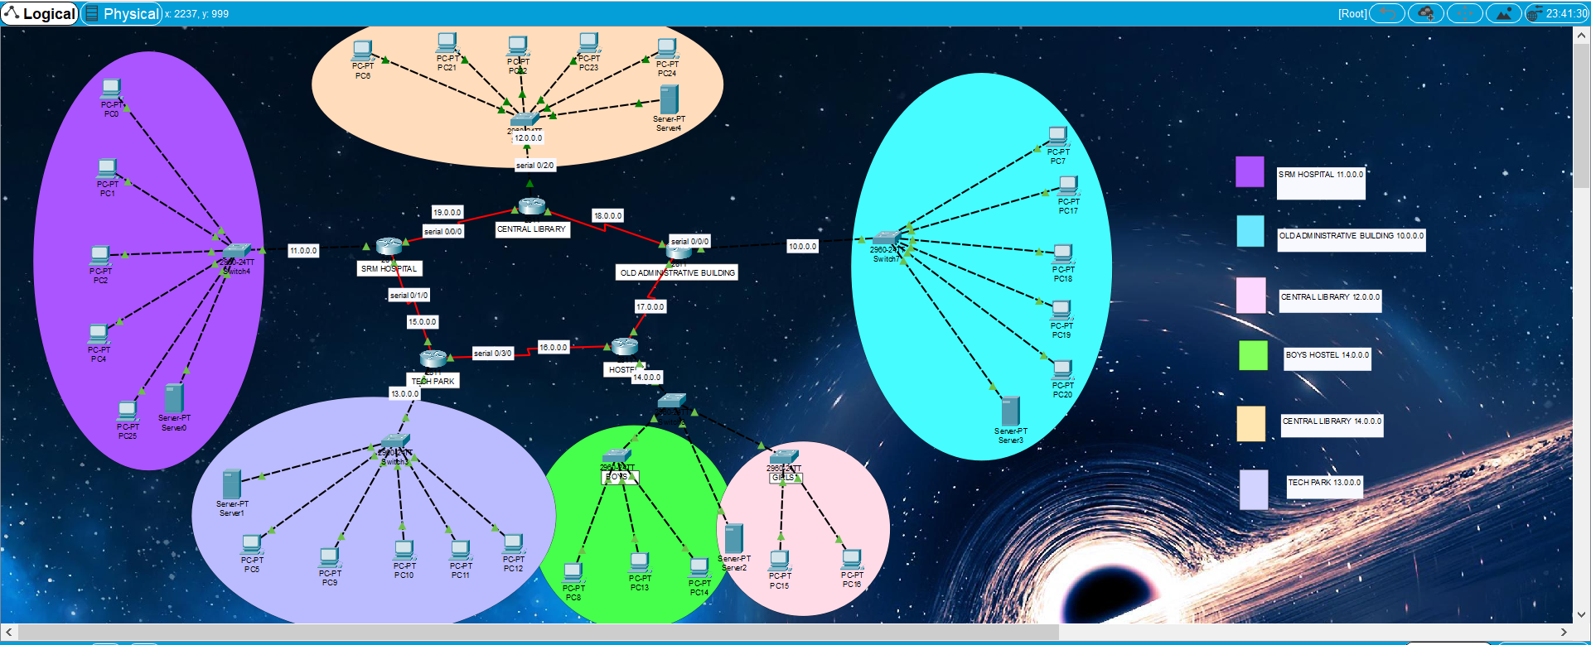
PROJECT OVERVIEW

Slide 4
PROJECT’S ARCHITECTURE
1. INSTITUTE IS DIVIDE INTO 5 NETWORK
A. TECH PARK (13.0.0.0)
B. OLD ADMINISTRATIVE BUILDING (10.0.0.0)
C. SRM HOSPITAL (11.0.0.0)
D. HOSTEL BOYS AND GIRLS (14.0.0.0)
E. CENTRAL LIBRARY (12.0.0.0)
2.ROUTING PROTOCOLS USED EIGRP
3. 5PC’S AND 1 SERVER are given to each particular network.
4. RING topology applied

Slide 5
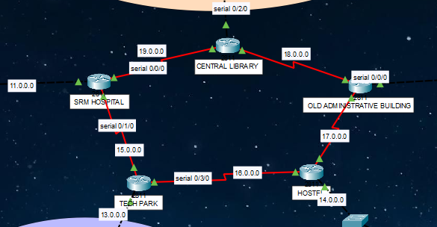
TOPOLOGY
In this project i had basically designed it in the RING topology, various parts of my university which includes various routers of different areas like TechPark, Srm hospital,
Boys hostel, girls hostel , Old aministrative building, Central library.

Slide 6
SPECIAL FEATURES
For the connection to be secure i had opt the following ways :
1.TELNET PASSWORD :
To configure Telnet password into the router or switch, first, move into the line configuration mode and use line vty0 4 command. Here ‘0 4’ means we are configuring the router for 0 to 4, i.e., total of 5 users can take router’s telnet at the same time.
2.ENABLE PASSWORD :
Enable password allows security on a Cisco router when a user moves from User Exec Mode to Privileged Exec Mode.

Slide 7
SPECIAL FEATURES (CONT’D)
3.ENABLE SECRET PASSWORD :
Enable secret password is quite similar to the Enable password. The main difference between Enable and Enable secret is the encryption. Enable password stored in a plain text format and is not encrypted. While in Enable secret password, a password is in encrypted form. Means Enable Secret Password is more secure as compare to Enable password.
4.CONSOLE PASSWORD :
Console password is used on a network when multiple users have to access the router. It prevents an unauthorized user from accessing the router.

Slide 8
PASSWORD TABLE
PASSWORD | SRM HOSPITAL | TECH PARK | HOSTEL | OLD ADMINISTRATIVE BIULDING | LIBRARY
ENABLE PASSWORD | hospital | techpark | hostel | admin | library
ENABLE SECRET PASSWORD | hospital1 | techpark1 | hostel1 | admin1 | library1
CONSOLE PASSWORD | hospital | techpark | hostel | admin | library
TELNET PASSWORD | hospital | techpark | hostel | admin | library

Slide 9
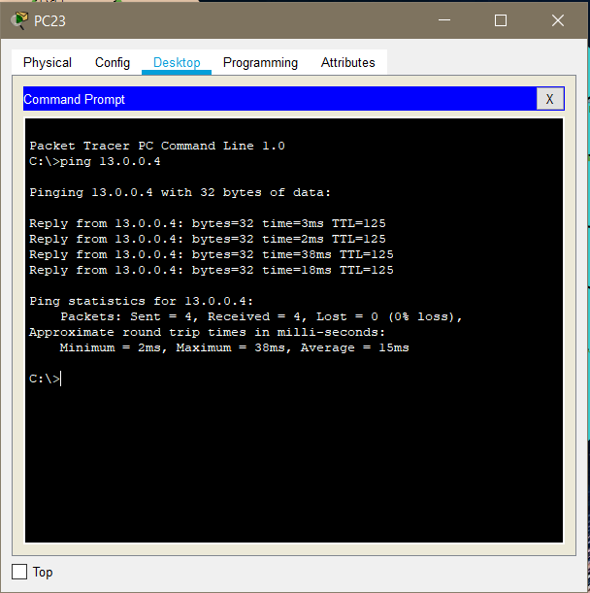
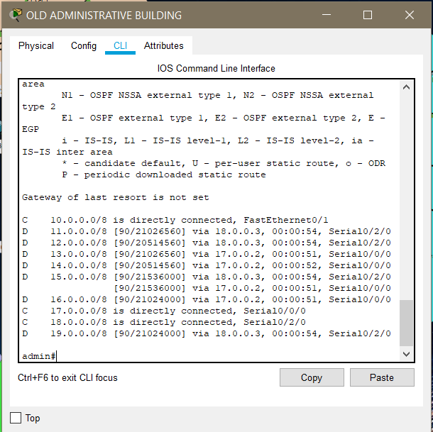
OUTPUTS

Slide 10
THANK YOU

